Slide 1
Capstone Project 1
Comparing Tennis Players in the Last Decade
Jeff Baksa

Slide 2
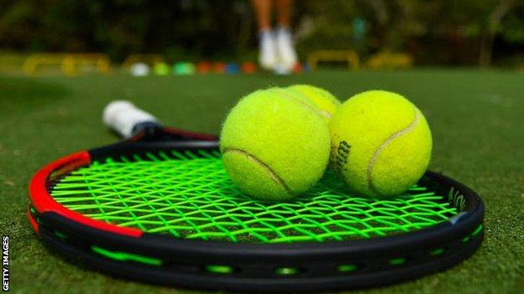
Motivation:
Having grown up in a household with multiple tennis fans, it was a topic I heard discussed and one I wanted to contribute to more and try to definitively answer.
Note: the data used is from 2010 - 2019
Coronavirus shortened 2020
2021 season is ongoing

Slide 3
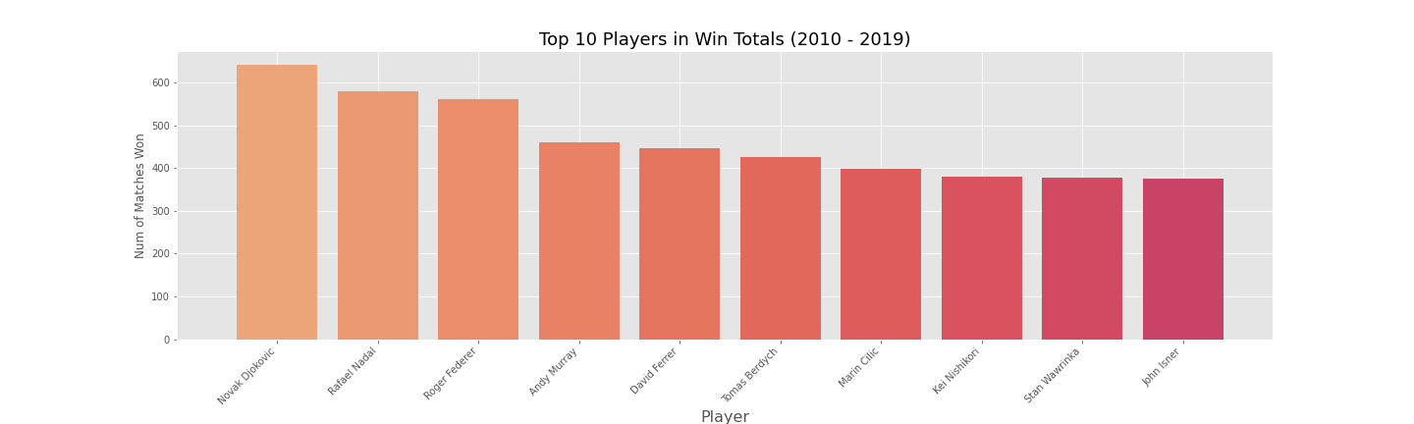
How To Select the Candidates?
Past decade has been dominated by 3 individuals in particular:
Novak Djokovic
Rafael Nadal
Roger Federer

Slide 4
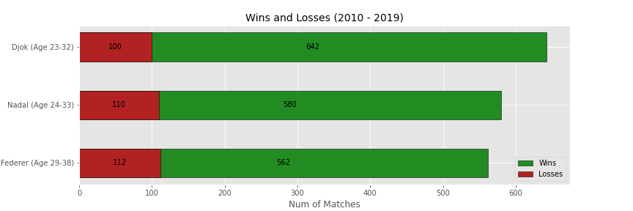
Closer Look at the 3 Players Between Each other
Winning Percentage:
Djokovic: 86.5%
Nadal: 84.1%
Federer: 83.4%

Slide 5
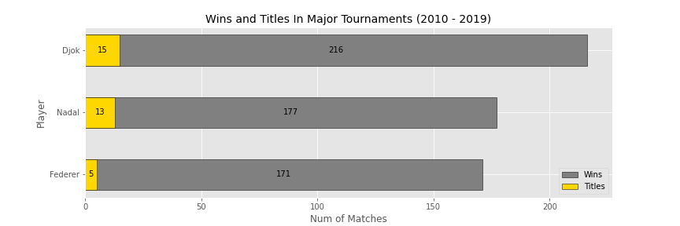
What about Major Tournaments?
Have won an impressive 33 of the 40 (82.5 %) major tournament titles
Have over 550 combined tournament wins

Slide 6
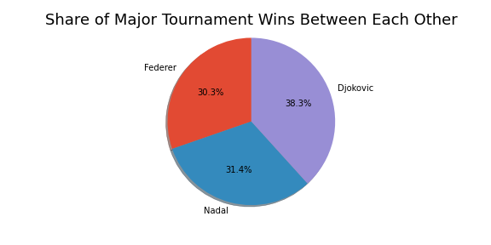
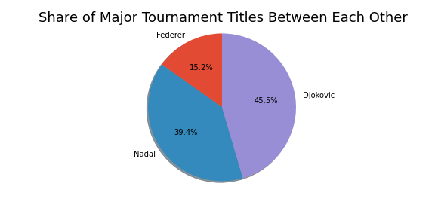
Major Tournaments Cont.

Slide 7
Based Off this Info...
Djokovic seems to clearly be the most dominate this past decade in terms of only wins, but all 3 players are more than worthy of the being crowned the best.
What stats will be considered in the hypothesis test?
1. Aces - serve with no return | 6. 2nd Serve Points Won
2. Serve Points | 7. Serve Games
3. 1st Serves Made | 8. Break Points Saved
4. 2nd Serves Made | 9. Double Faults - two serves out of bounds
5. 1st Serve Points Won | 10. Break Points Faced - num of times opponent has a chance to win game while serving

Slide 8
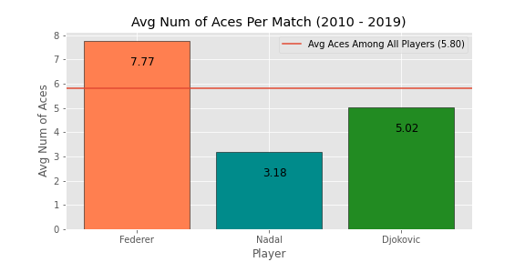
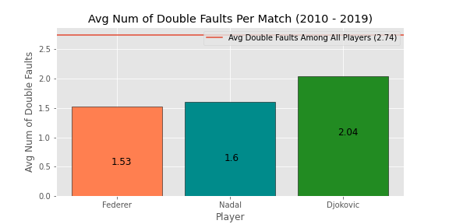
Quick Look into Those Specific Stats
How the three compared to both each other and the rest of the field for each statistic
Not all of these stats are considered good
Ie: better to have less of double faults
This was taken into consideration when performing hypothesis testing

Slide 9
Hypothesis Test 1
Using the Mann Whitney U Test...
 | Federer Wins | Nadal Wins | Total Trials | P-Value | Reject Null?
Aces | 379443 | 85617 | 465060 | 0 | Reject Null
Serve Points | 244524 | 220536 | 465060 | 0.04956 | Reject Null
1st Serve In | 220722.5 | 244337.5 | 465060 | 0.94779 | Fail to Reject Null
1st Serve Points Won | 252314 | 212709 | 465023 | 0.00326 | Reject Null
2nd Serve Points Won | 292803 | 172260 | 465063 | 0 | Reject Null
Service Games | 263752.5 | 201334.5 | 465087 | 0.00001 | Reject Null
Break Points Saved | 203418 | 261642 | 465060 | 0.99997 | Fail to Reject Null
Wins | 230960 | 234100 | 465060 | 0.63221 | Fail to Reject Null
Double Faults | 227241 | 237819 | 465060 | 0.22702 | Fail to Reject Null
Break Points Faced | 197077 | 267983 | 465060 | 0 | Reject Null
H₀: Federer is worse than or equal to Nadal in terms of metrics
H_{A}: Federer is better than Nadal in terms of metrics
𝛂 = 0.05

Slide 10
Hypothesis Test 2
Metric | Reject Null?
Aces | ❌
Serve Points | ❌
1st Serve In | ❌
1st Serve Points Won | ❌
2nd Serve Points Won | ❌
Service Games | ❌
Break Points Saved | ✅
Wins | ✅
Double Faults | ❌
Break Points Faced | ❌
H₀: Djokovic is worse than or equal to Federer in terms of metrics
H_{A}: Djokovic is better than Federer in terms of metrics
𝛂 = 0.05
✅ = Reject null hypothesis
❌ = Fail to reject null hypothesis

Slide 11
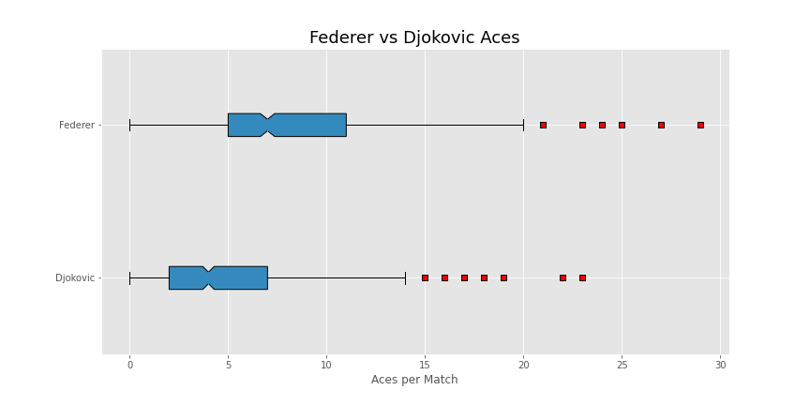
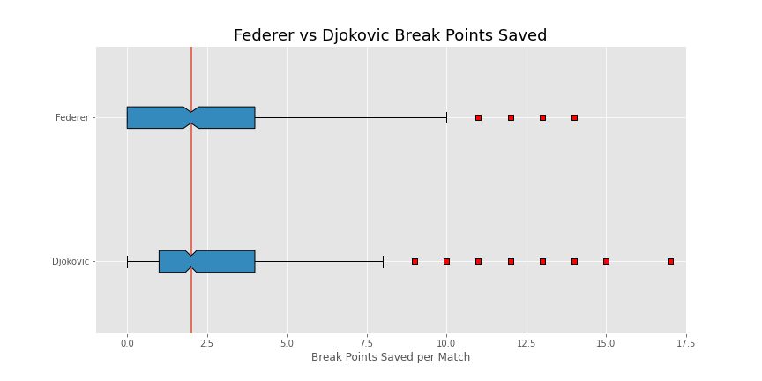
...How can this be?
I was initially surprised by the results considering how obvious it seemed that Djokovic was the most dominant.
These tests primarily focus on / favor the better server
One of Federer’s strongest attributes
Doesn’t take defensive stats into account as much, like break points saved, Djokovic’s primary strength

Slide 12
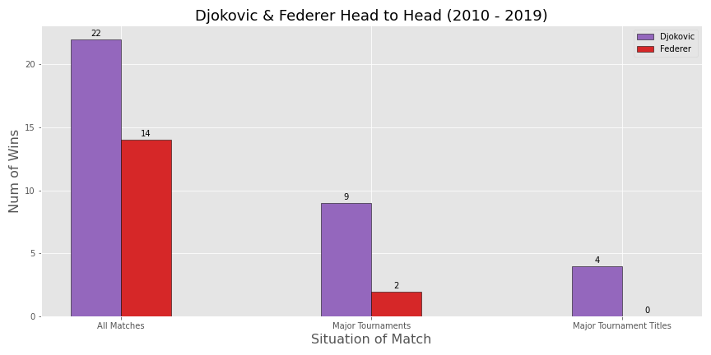
...How can this be? cont.
Federer and Djokovic’s head to head record shines additional light on why my initial assumptions proved to be incorrect
Many losses for Federer in Major tournaments came directly from Djokovic

Slide 13
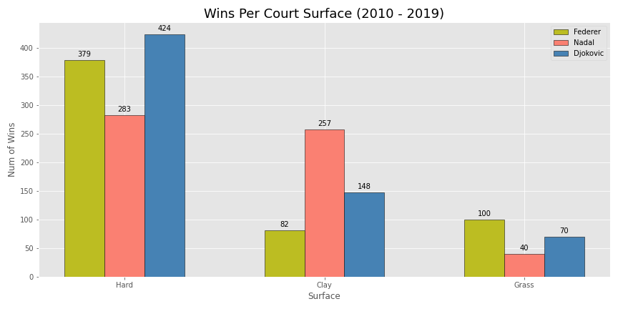
And Surfaces?
Tennis is unique in that not all playing conditions are the same
Surface does have a significant impact on some players performance
Hard: US Open, Australian Open
Clay: French Open
Grass: Wimbledon

Slide 14
Hypothesis Test 3
Metric | Reject Null?
Aces | ❌
Serve Points | ❌
1st Serve In | ❌
1st Serve Points Won | ❌
2nd Serve Points Won | ❌
Service Games | ❌
Break Points Saved | ❌
Wins | ❌
Double Faults | ✅
Break Points Faced | ❌
H₀: Nadal is worse than or equal to Djokovic in terms of metrics
H_{A}: Nadal is better than Djokovic in terms of metrics
𝛂 = 0.05
✅ = Reject null hypothesis
❌ = Fail to reject null hypothesis

Slide 15
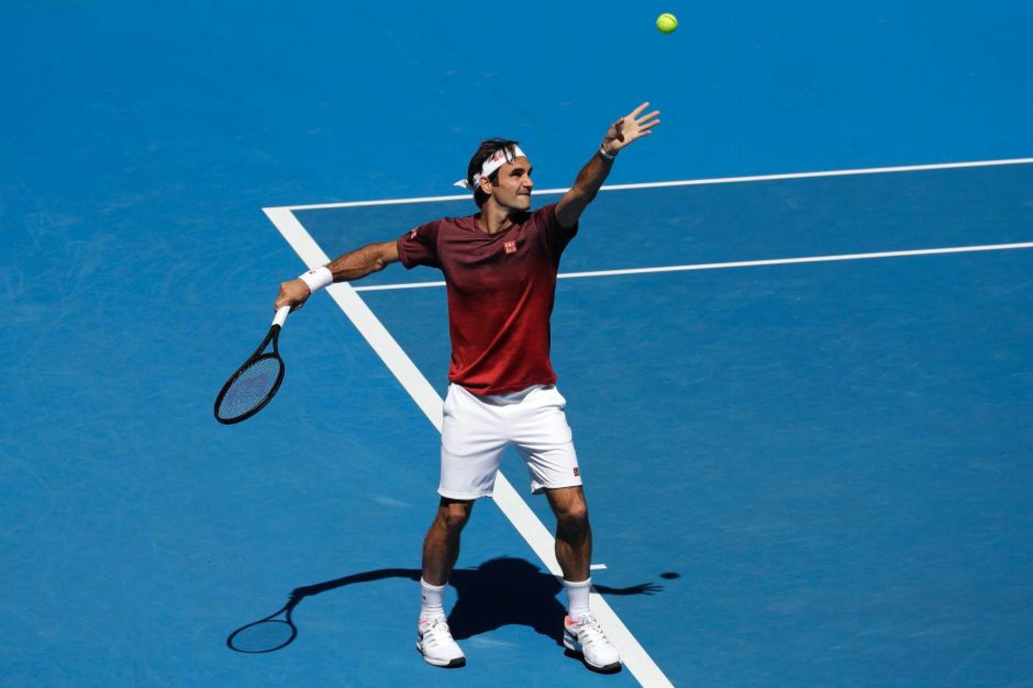
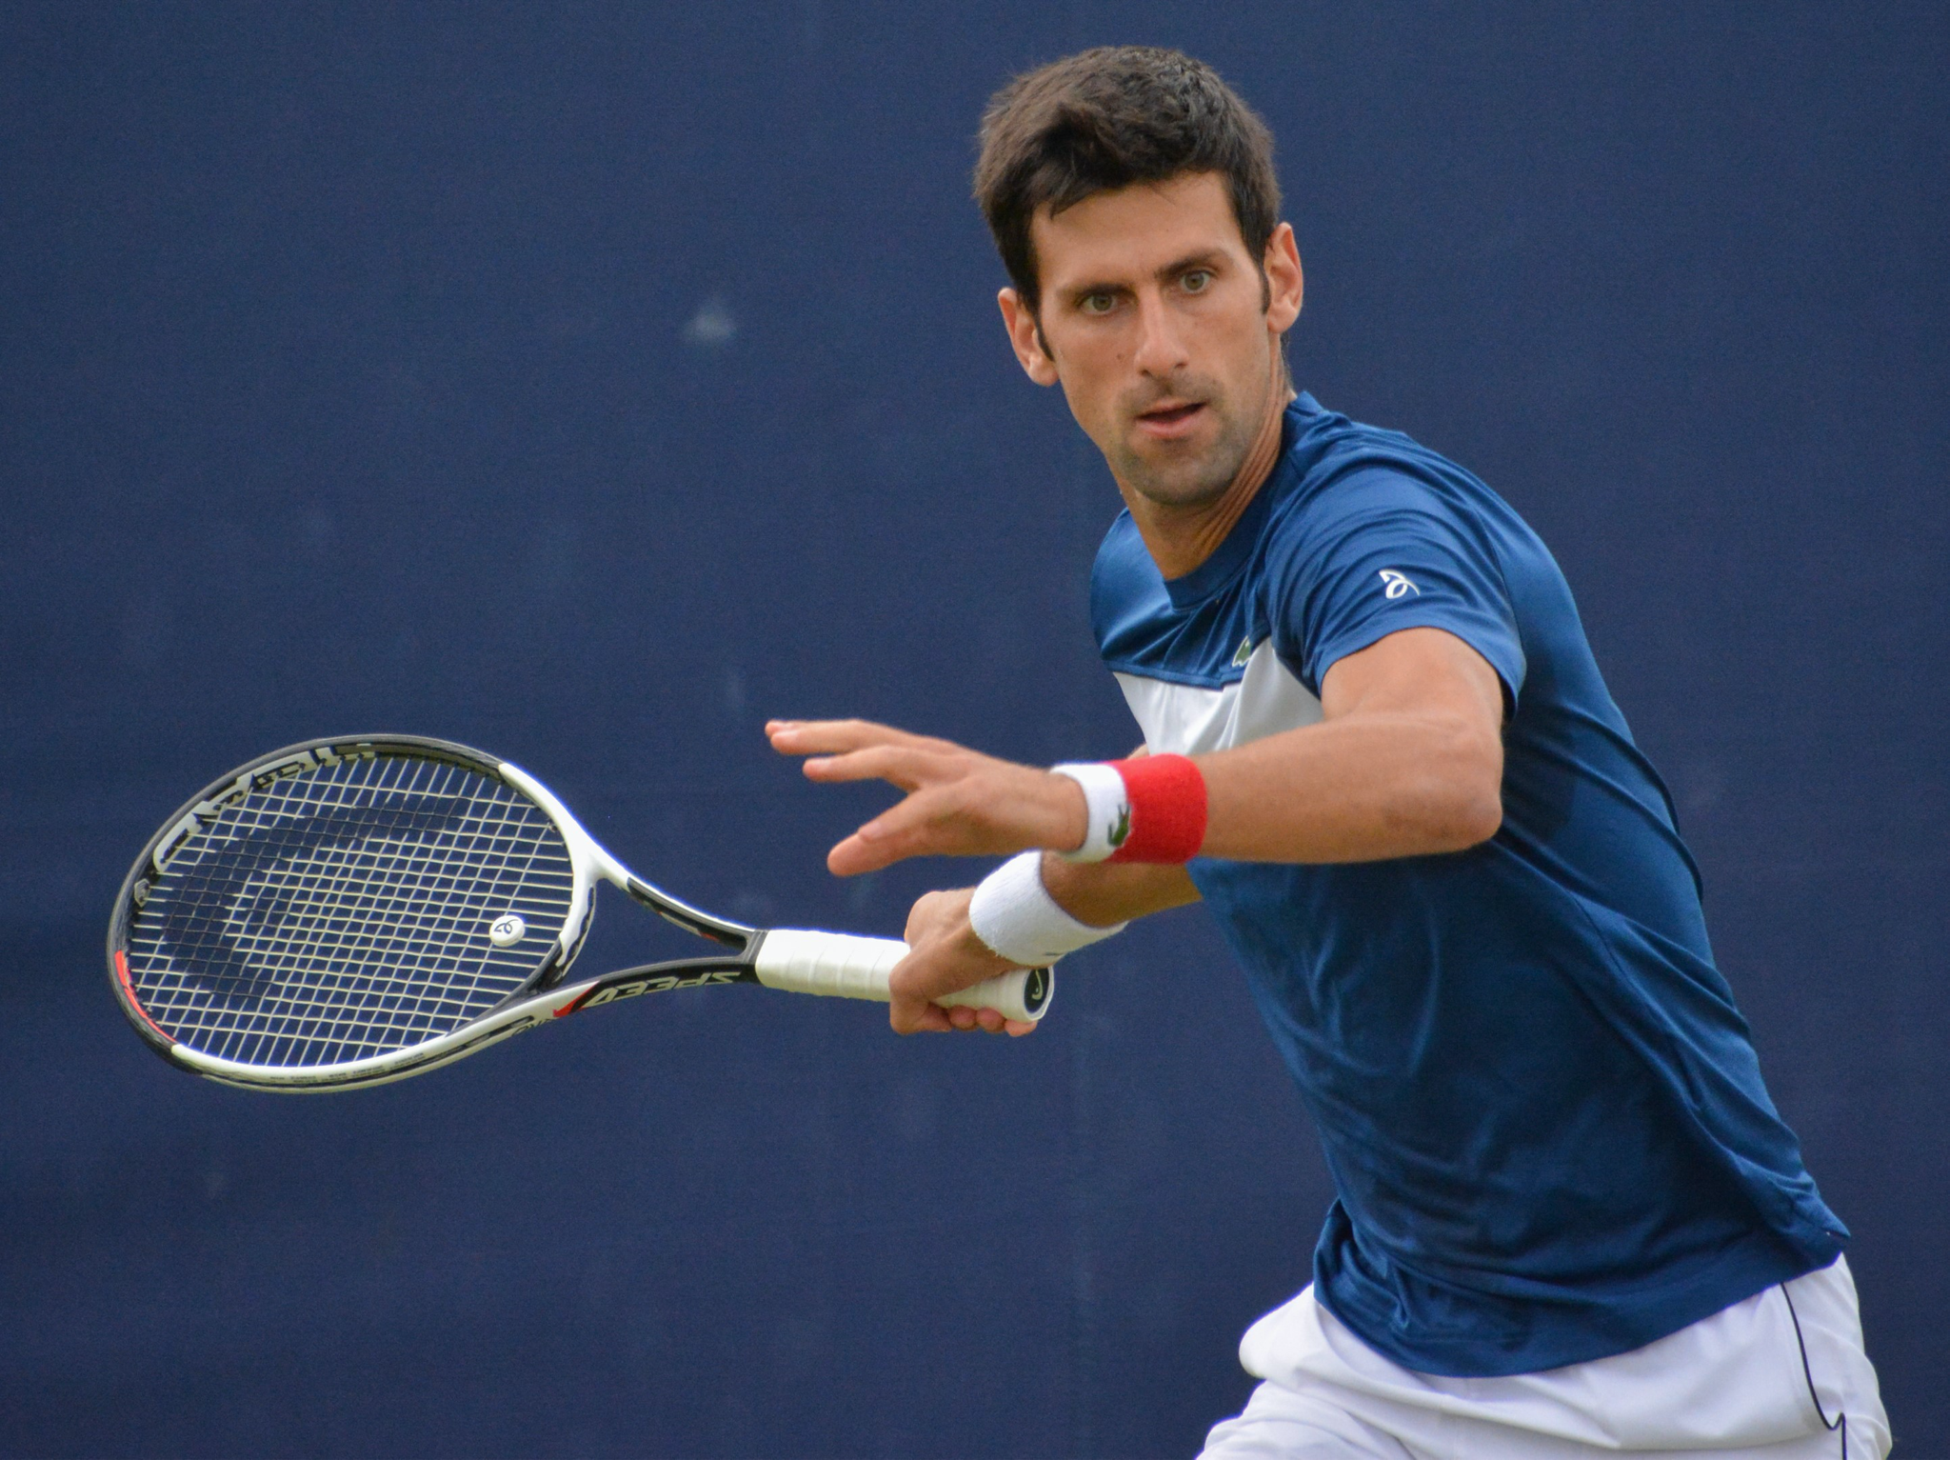
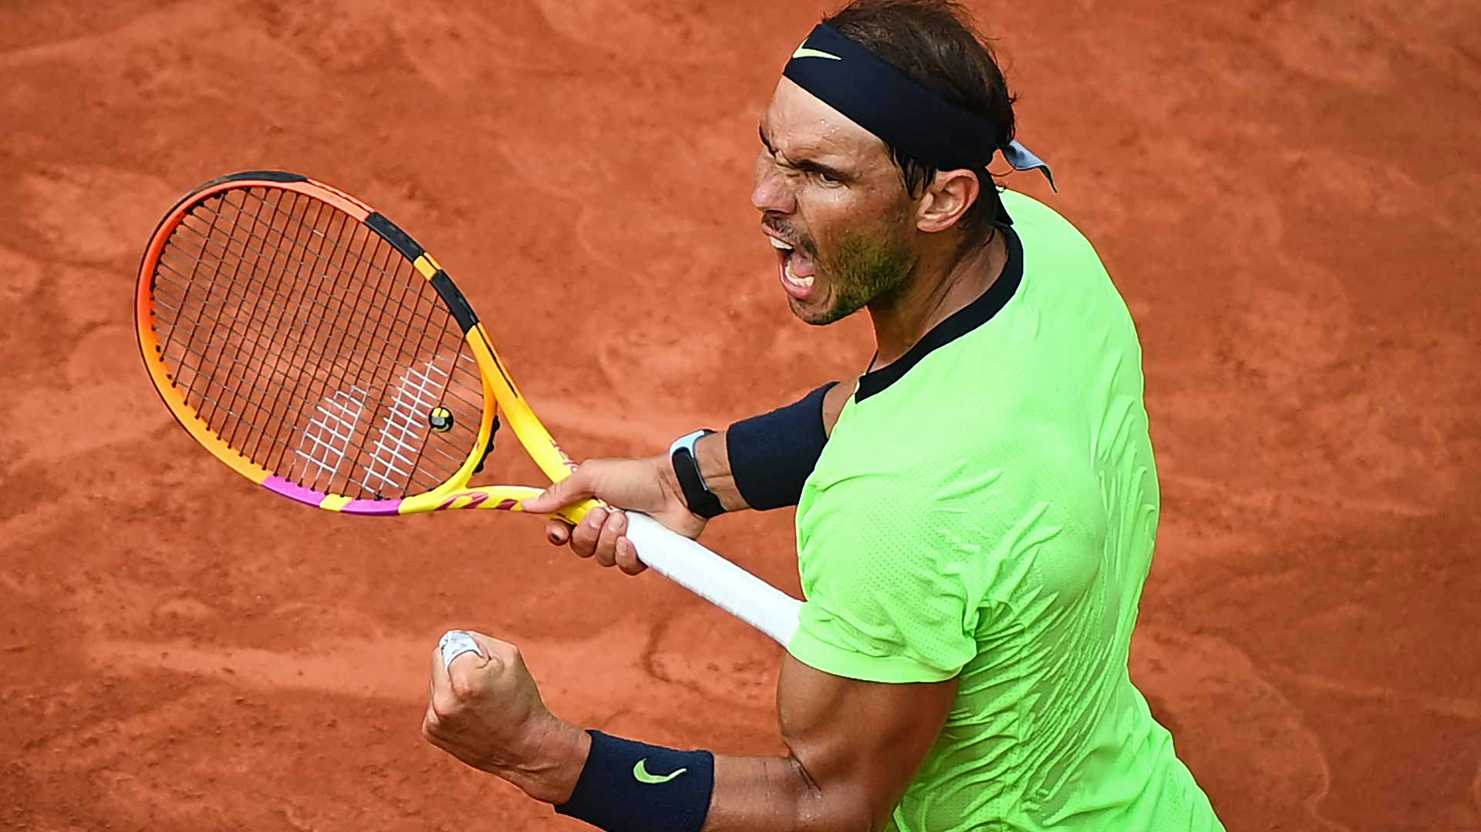
Conclusion
Final order ranking for the past decade with 95% confidence:
Federer
Djokovic
Nadal
In the future I would try to find a dataset that included more diverse stats that don’t focus around one aspect of the game more than others
Or attempt to weigh categories appropriately

Slide 16
Data Sources and Technologies
https://github.com/JeffSackmann/tennis_atp
Python
Pandas
Numpy
Matplotlib

